Slide 1

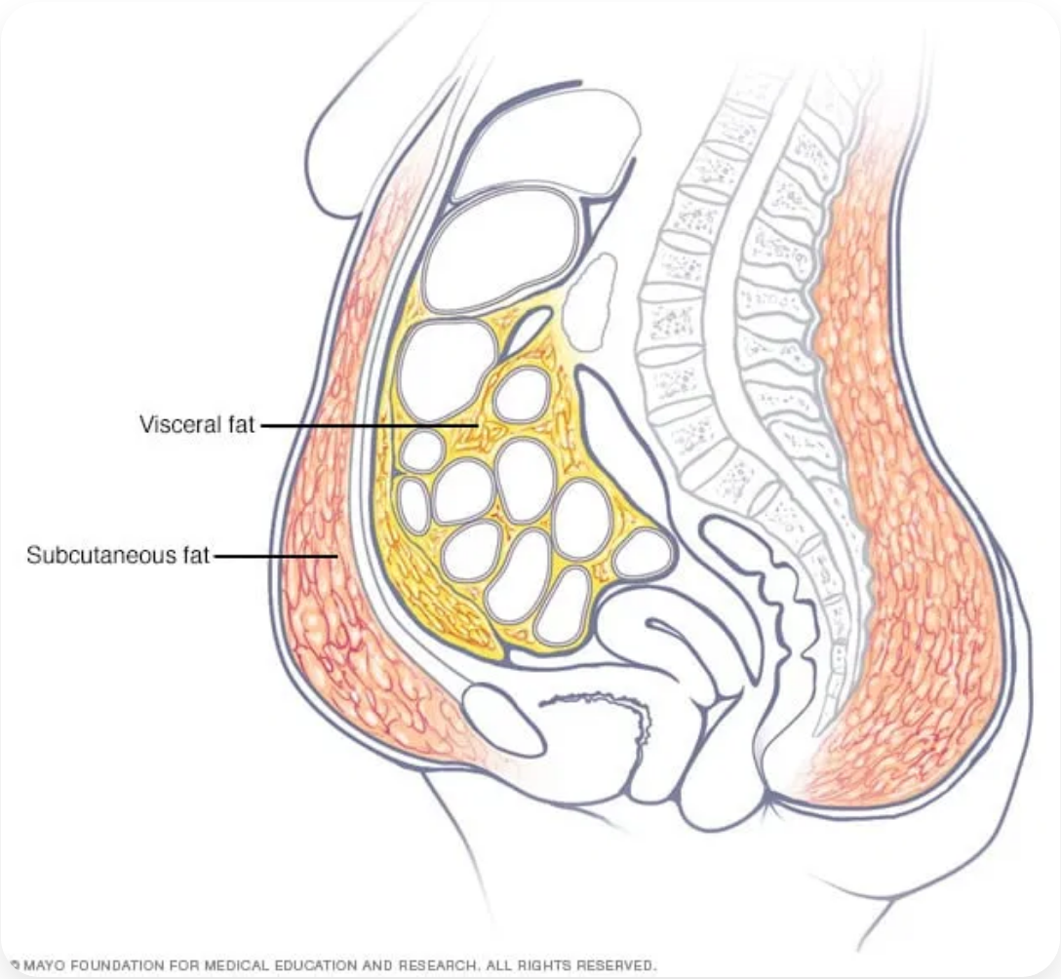
Predicting Visceral Fat Risk
Machine Learning
Data Analysis
June 2024

Slide 2

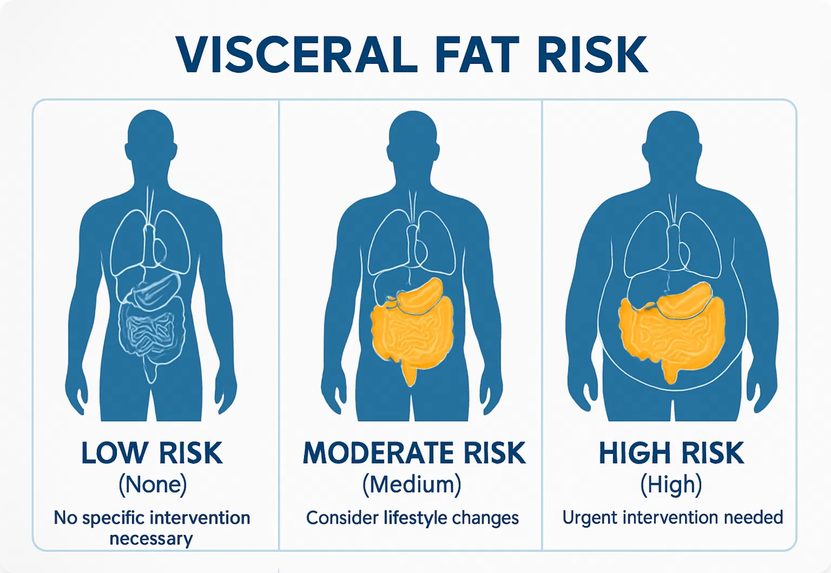
The Hidden Health Risk
What is Visceral Fat?
Visceral fat is fat that accumulates around internal organs in the abdominal cavity, unlike subcutaneous fat which sits just under the skin.
Why It Matters
Visceral fat is a critical factor in determining susceptibility to serious health conditions:
Health Risks:
• Diabetes
• Cardiovascular diseases
• Various cancers
• Chronic illnesses
Early identification enables targeted interventions to reduce health risks.

Slide 3

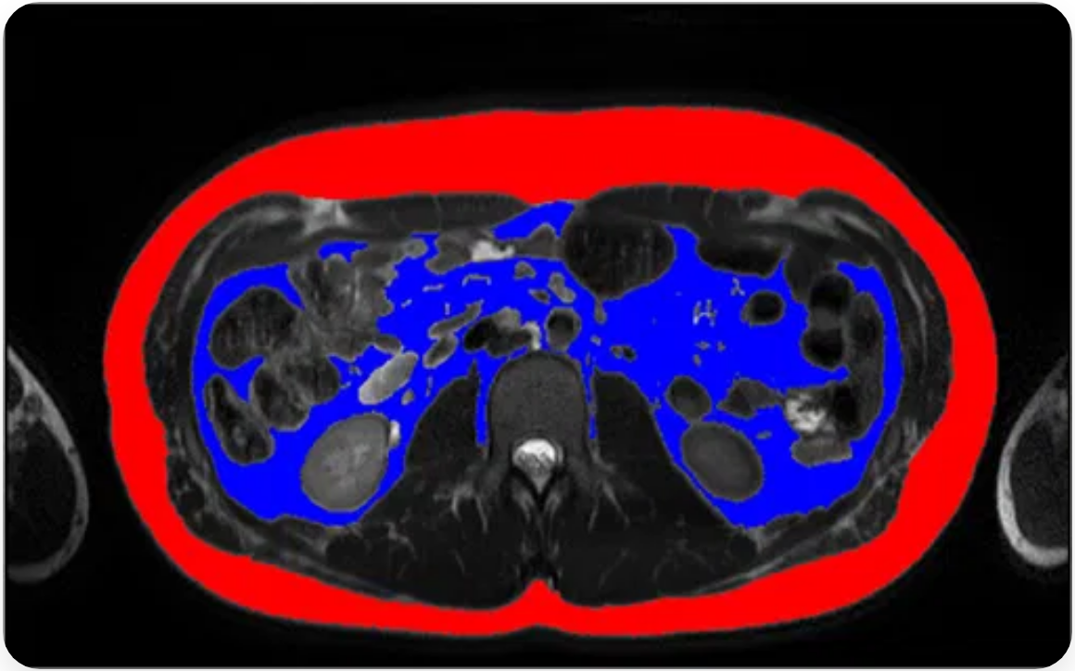
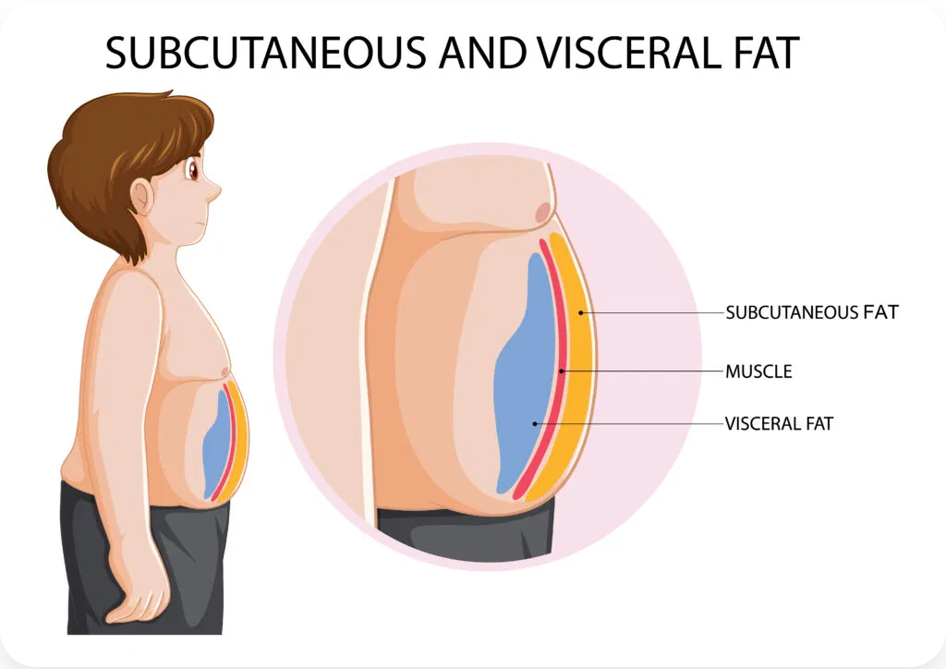
The Current Challenge
Current Detection Method: MRI Scans
Visceral fat is currently measured using Magnetic Resonance Imaging (MRI) scans, which provide detailed internal body images.
Major Limitations:
•
Cost: £450-£600 per scan
•
Time: Up to 90 minutes per scan
•
Specialist required: Radiologist interpretation
•
Results delay: Weeks to receive results
The Appearance Paradox:
• "Thin Outside, Fat Inside" - Slim people with dangerous VF levels
• "Thin Inside, Fat Outside" - Athletes with low VF despite appearance

Slide 4



Mission
Can we predict intervention urgency without MRI scans?
Using machine learning to identify who needs lifestyle and diet changes based on easily measurable factors
Classification Approach
Value Proposition
We treat this as a classification problem with three risk categories:
Cost-effective screening:
Eliminate expensive MRI scans for initial assessment
None
Medium
High
Earlier interventions:
Low Risk
Moderate Risk
High Risk
Identify at-risk individuals before symptoms appear
Better health outcomes:
Enable preventive care and lifestyle modifications
Scalable solution:
Screen large populations efficiently

Slide 5

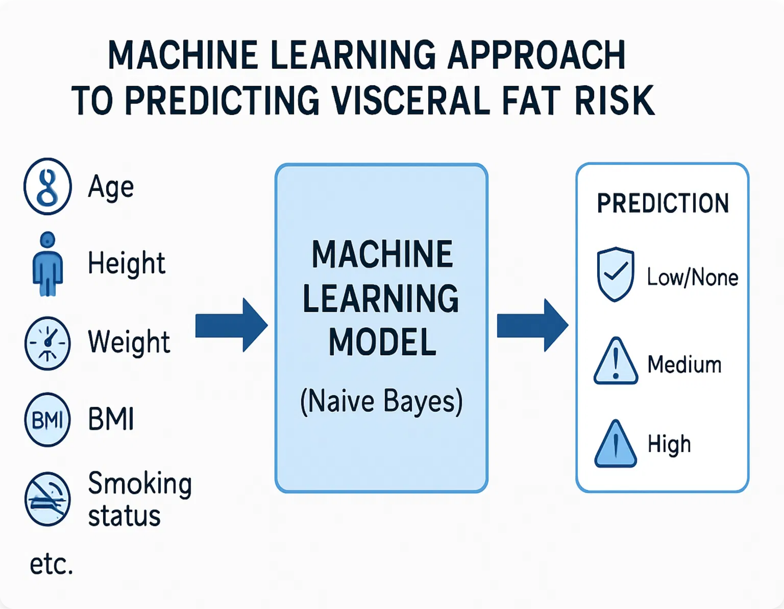
Approach
Dataset Overview
We used a female dataset with historical visceral fat measurements from MRI scans.
Key Variables Used:
Age
Height
Weight
BMI
Smoking Status
Computer Use Time
Blood Pressure
Visceral Fat Volume
Data Preparation Process:
• Removed unnecessary columns
• Handled outliers and missing values
• Standardized categorical variables
• Fixed data quality issues
• Addressed class imbalance

Slide 6







Model Selection & Evaluation
Models Tested
Evaluation Criteria
Our healthcare success criteria guided our model evaluation:
Naïve Bayes
Decision Trees
Non-parametric model that applies Bayes' theorem with strong independence assumptions between features.
Non-parametric model that creates a flowchart-like structure to make decisions based on feature values.
1
Primary: Recall for High & Medium Risk
Identify the largest number of subjects in high and moderate-risk groups to recommend interventions and potentially save lives.
2
Secondary: Precision for Low Risk
K-Nearest Neighbor
Neural Networks
Reasonably identify those who are low-risk to minimize unnecessary lifestyle and diet changes.
Non-parametric model that classifies based on the majority class among k nearest data points.
Parametric model with multi-layer perceptron architecture that mimics human brain connections.
3
Overall: F1 Score
Balance between precision and recall to ensure overall model effectiveness.

Slide 7

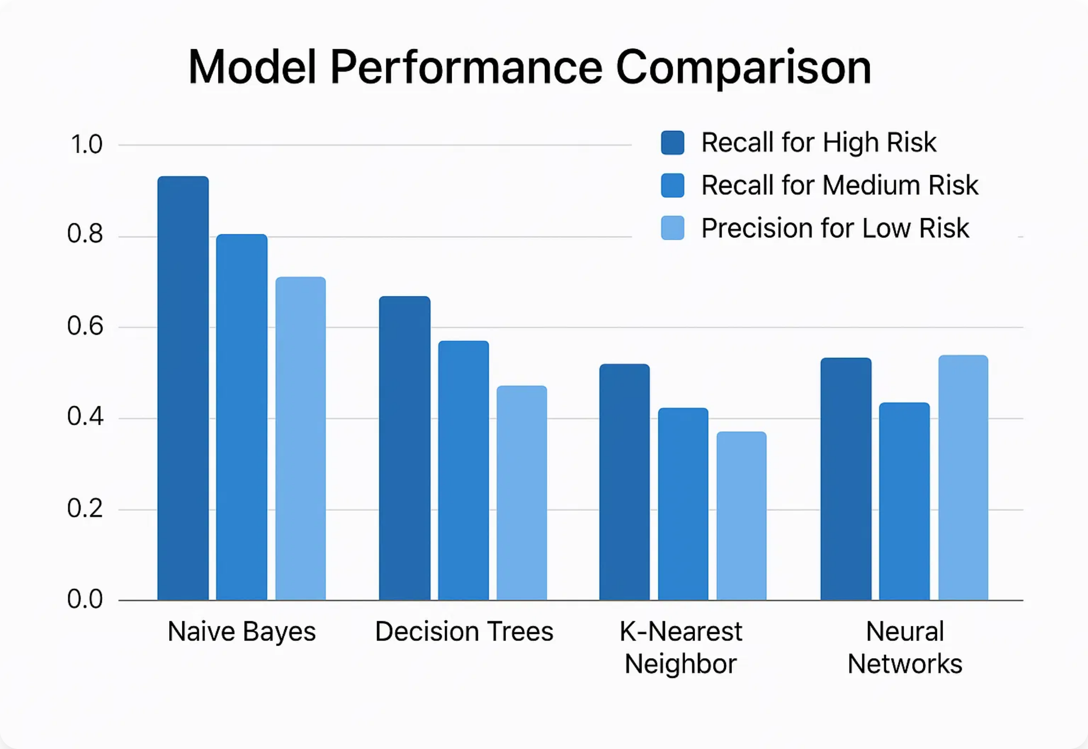
Results & Best Model
🏆
Naïve Bayes
Our winning model!
Best performance across all healthcare success criteria
Why Naïve Bayes Won:
Recall for High Risk
Highest
Recall for Medium Risk
Highest
Precision for Low Risk
Highest
F1 Score
Best Overall

Slide 8



How Close Are We to the Solution?
Strengths
Current Limitations
✓
Successfully identifies high and medium risk cases with high recall
!
Class imbalance in dataset affects performance
!
Assumes feature independence (may not always hold)
✓
Minimizes false alarms for low-risk individuals
!
Limited to female subjects only
✓
Uses easily measurable variables (no MRI required)
!
Requires balanced dataset for optimal performance
✓
Fast and cost-effective screening
!
Business requirements for data cleaning could improve results
✓
Hyperparameter optimization showed model is well-tuned
We're Very Close!
Our model successfully addresses the healthcare priorities and provides a viable alternative to expensive MRI screening. With balanced data and further refinement, we can achieve even better results.

Slide 9





Real-World Impact
🏥
⚡
💰
Healthcare Screening
Early Intervention
Cost Reduction
Enable population-wide screening for visceral fat risk without expensive MRI scans
Identify at-risk individuals before symptoms appear, enabling preventive care
Dramatically reduce healthcare costs by avoiding unnecessary MRI scans
Potential Cost & Time Savings
£450-£600
90 minutes
Saved per person
Time saved per person
(MRI cost avoided)
(MRI scan duration)
Potential Applications
Primary care screening
Preventive health programs
Population health monitoring
Mobile health applications

Slide 10



Next Steps & Conclusion
Implementation Recommendations
Future Improvements
1
Pilot program in primary care settings
1
Address class imbalance with balanced datasets
2
Integrate with existing health screening protocols
2
Extend model to male subjects
3
Develop user-friendly interface for healthcare providers
3
Explore ensemble methods for better performance
4
Validate with larger, more diverse datasets
4
Incorporate additional biomarkers
Key Takeaways
🎯
💡
🚀
Proven Concept
Healthcare Impact
Ready for Implementation
Machine learning can effectively predict visceral fat risk without MRI scans
Significant potential for cost savings and early intervention
Model meets healthcare success criteria and is ready for pilot testing

